Slide 1

Time complexity Analysis and Asymptotic Bounds

Slide 2
Examples step counts
long fact(int n){
if (n==0)
return 1;
Long ans=1;
for(int i=1;i<=n;i++)
ans=ans*i;
return ans;
}
Notes:
1
1
n+1
n
1
T(n) = 2n+4 = O(n)
Cost no. of time
1 c1 1
1 c2 0
1 c3 1
2 c4 n+1
2 c5 n
1 c6 1
The most common metric for calculating time complexity is Big O notation. This removes all constant factors so that the running time can be estimated in relation to N as N approaches infinit

Slide 3
First Example
int mean(int a[], size_t n)
{
int sum = 0;
for (int i = 0; i < n; i++)
sum += a[i];
return sum;
}
Notes:
int mean(int a[], size_t n)
{
int sum = 0; --------1
for (int i = 0; i < n; i++) -------n+1
sum += a[i]; --------- n
return sum; --------- 1
}

Slide 4
Example 2
long foo(int n){
long x=0;
if (n==0)
return 1;
Long ans=1;
for(int i=1;i<=n;i++) {
for (int j =0; j<n; j++)
x*=j;
ans*=i;
ans+=x;}
return ans;
}
Notes:
for(int i=1;i<=m;i++)
for (int j =0; j<n; j++)
Ans: O(N²)
The most common metric for calculating time complexity is Big O notation. This removes all constant factors so that the running time can be estimated in relation to N as N approaches infinit
Hum ne aik idea hi laina hai. K is ki growth kia aa rahi hai is ka relation kia aa raha hai.
sum = 0;
for( i = 0; i < n; ++i )
for( j = 0; j < n; ++j )
++sum;

Slide 5
Example 3
sum = 0;
for( i = 0; i < n; ++i )
for( j = 0; j < n * n; ++j ){
++sum;
x=+1}
Note: Independent Nested Loop
Notes:
Answer:n3

Slide 6
Example 4
sum = 0;
for( i = 0; i < n; ++i )
for( j = 0; j < i; ++j )
++sum;
Note: Dependent Nested Loop
Notes:
The time complexity of this code is O(n^2), which means that the execution time grows quadratically with the size of n.
The outer loop has n iterations and the inner loop has i iterations, where i ranges from 0 to n-1. The total number of iterations for both loops is equal to the sum of the first n positive integers, which is n * (n + 1) / 2, and grows as n^2.

Slide 7
Example 5
sum = 0;
for( i = 0; i < n; ++i )
for( j = 0; j < i * i; ++j )
for( k = 0; k < j; ++k )
++sum;
Notes:
The outermost for loop runs for n iterations.
Within the outermost for loop, there is a second for loop that runs for i^2 iterations, where i ranges from 0 to n-1.
Within the second for loop, there is a third for loop that runs for j iterations, where j ranges from 0 to i^2-1.
To calculate the total number of iterations, we need to sum up the number of iterations for each value of i in the second for loop. The number of iterations for each value of i is i^2 * j, where j ranges from 0 to i^2-1.
The final complexity is O(n^4) as the highest order term is n^4

Slide 8
Example 6
Int sum=0;
for (int j = 1; j < n; j = j * 2)
++sum;
Int sum=0;
for (int j = 1; j < n; j = j * k)
++sum;
Notes:
1,2,4,8,16,32….
Answer:Log2(n) running time of the code is O(logk(n)) Application: Bianary Search Balanced Tree Traversal Divide and Conquer, Merge SortO(nlgn)

Slide 9
Example 7
Int sum=0;
for (int j = 1; j < n; j = j + 2)
++sum;
Notes:
In each iteration of the loop, the value of j is increased by 2, so it takes approximately n/2 iterations for the loop to complete. The cost of incrementing sum in each iteration is a constant time operation, so the overall time complexity is O(n). 1, 3, 5, 7, ..., n-1

Slide 10
Problems with T(n)
T(n) is difficult to calculate
T(n) is also not very meaningful as step size is not exactly defined
T(n) is usually very complicated so we need an approximation of T(n)….close to T(n).
This measure of efficiency or approximation of T(n) is called ASYMPTOTIC COMPLEXITY or ASYMPTOTIC ALGORITHM ANALYSIS
Asymptotic complexity studies the efficiency of an algorithm as the input size becomes large
10

Slide 11
Example
If T(n) = 7n+100
What is T(n) for different values of n???
n | T(n) | Comment
1 | 107 | Contributing factor is 100
5 | 135 | Contributing factor is 7n and 100
10 | 170 | Contributing factor is 7n and 100
100 | 800 | Contribution of 100 is small
1000 | 7100 | Contributing factor is 7n
10000 | 70100 | Contributing factor is 7n
10⁶ | 7000100 | What is the contributing factor????
When approximating T(n) we can IGNORE the 100 term for very large value of n and say that T(n) can be approximated by 7(n)

Slide 12
Example 2
T(n) = n² + 100n + log₁₀n +1000
n | T(n) | n² |  | 100n |  | log₁₀n |  | 1000
 |  | Val | % | Val | % | Val | % | Val | %
1 | 1101 | 1 | 0.1% | 100 | 9.1% | 0 | 0% | 1000 | 90.8%
10 | 2101 | 100 | 5.8% | 1000 | 47.6% | 1 | 0.05% | 1000 | 47.6%
100 | 21002 | 10000 | 47.6% | 10000 | 47.6% | 2 | 0.99% | 1000 | 4.76%
10⁵ | 10,010,001,005 | 10¹⁰ | 99.9% | 10⁷ | .099% | 5 | 0.0% | 1000 | 0.00%
When approximating T(n) we can IGNORE the last 3 terms and say say that T(n) can be approximated by n²

Slide 13
Analysis Cases
In general, we are interested in three types of performance
Best-case / fastest
Symbol Ω. Example; Ω(n²)
Average-case
Symbol θ. Example; θ(logn)
Worst-case/ slowest
Symbol O. Example; O(n)

Slide 14
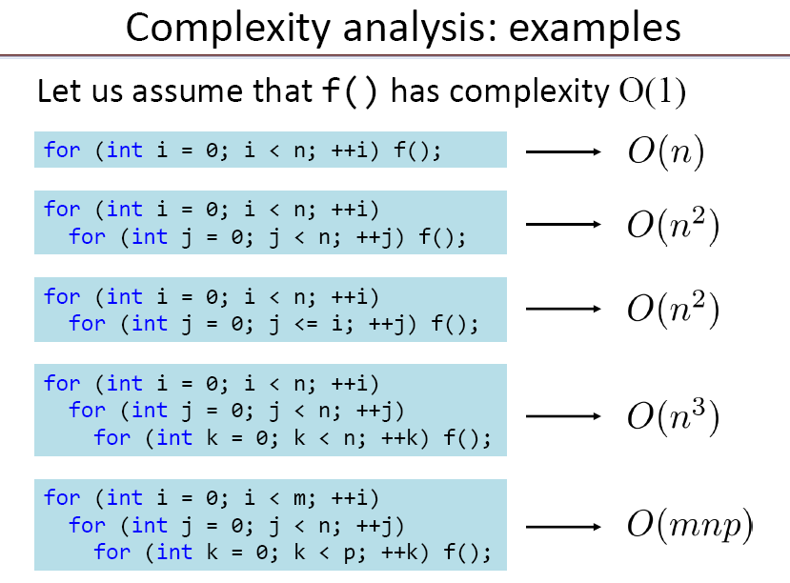

Slide 15
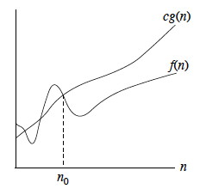
Big-Oh
Definition:
f(n) is O(g(n)) if there exist positive numbers c & N such that f(n)<=cg(n) for all n>=N
g(n) is called the upper bound on f(n) OR
f(n) grows at the most as large as g(n)
Example:
T(n) = n² + 3n + 4
n² + 3n + 4 <= 2 n² for all n>10
so we can say that T(n) is O(n²) OR
T(n) is in the order of n^{2.}
T(n) is bounded above by a + real multiple of n²

Slide 16
Big O??
Running Time: O(1)+O(n)+O(n)= O(n)
void print(int * array, int size){
cout<<"Array: ";
for(int i = 0; i < size; i++)
cout <<array[i]<<" ";
cout<<endl;
}
int smallest(int array[], int size, int start){
if(start == size-1)
return start;
else
{
int small = start;
for(int i = start+1; i <size; i++){
if(array[small]>array[i])
small= i;
}
return small;
}
}
void main(){
const int n= 5;
int array[n]={3,5,9,6,1};
cout<<"Smallest: "<<array[smallest(array,n,0)]<<endl;
print(array,n);
}
O(n)
O(1)
O(n)
O(n)
O(1)
O(n)
O(n)

Slide 17
Big-O?
void sortArray(int * a, int size){
for(int i = 0;i<size;i++){
int small = smallest(a,size,i);
int temp = a[i];
a[i] = a[small];
a[small] = temp;
}
}
void main(){
const int n= 5;
int array[n]={3,5,9,6,1};
sortArray(array,n);
print(array,n);
}
O(n²)
O(n)
O(n)
O(1)
Running Time: O(1)+O(n²)+O(n)= O(n²)

Slide 18
Big-O?
void main(){
const int n= 5;
int array[n]={3,5,9,6,1};
for(int i =0; i <n; i++)
sortArray(array,n);
print(array,n);
}
O(n³)
O(n²)
Running Time: O(1)+ O(n³) = O(n³)

